Slide 1



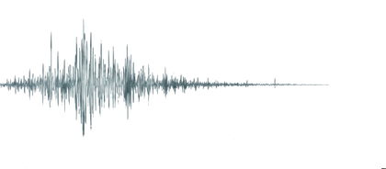
Presentation title
Author(s)
Affiliation(s)
Seismology and Earth Sciences Conference, 10 November 2026 Magurele, Romania

Slide 2


